Slide 1
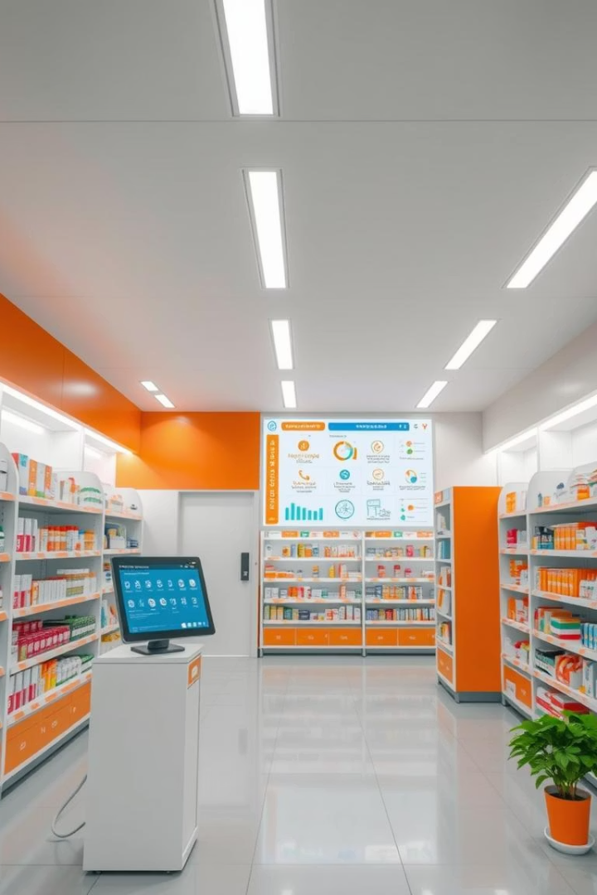
Pharmacy Management System Presentation Project
Name: Mahamat Adji Zezerti Abdramane
ID: 25718
Capstone Project for academic year 2024-2025

Slide 2
Introduction
Overview
Objectives
Scope
Automates pharmacy operations: inventory, sales, prescriptions, auditing
Streamline drug management
Database schema, triggers, PL/SQL, scheduler
Ensure data integrity
Automate inventory checks
Built using Oracle 21c for scalability

Slide 3
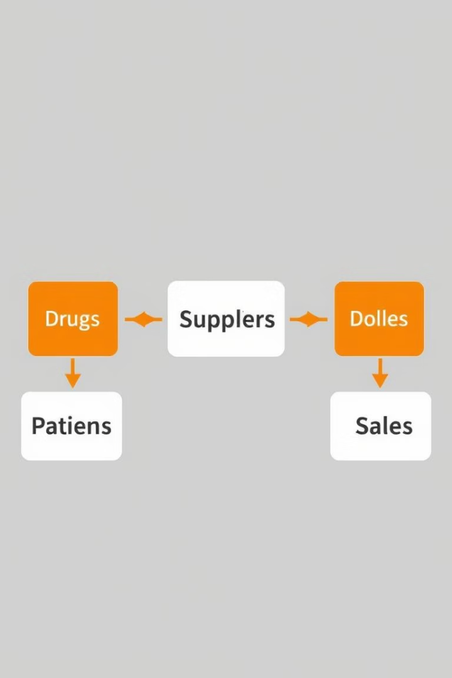
Problem Definition
Issues
Challenges
Manual processes cause inefficiencies
Restricting unauthorized DML
Errors in inventory and sales tracking
Ensuring secure, concurrent access
Lack of audit trails for modifications
Need
Robust database for pharmacy management

Slide 4
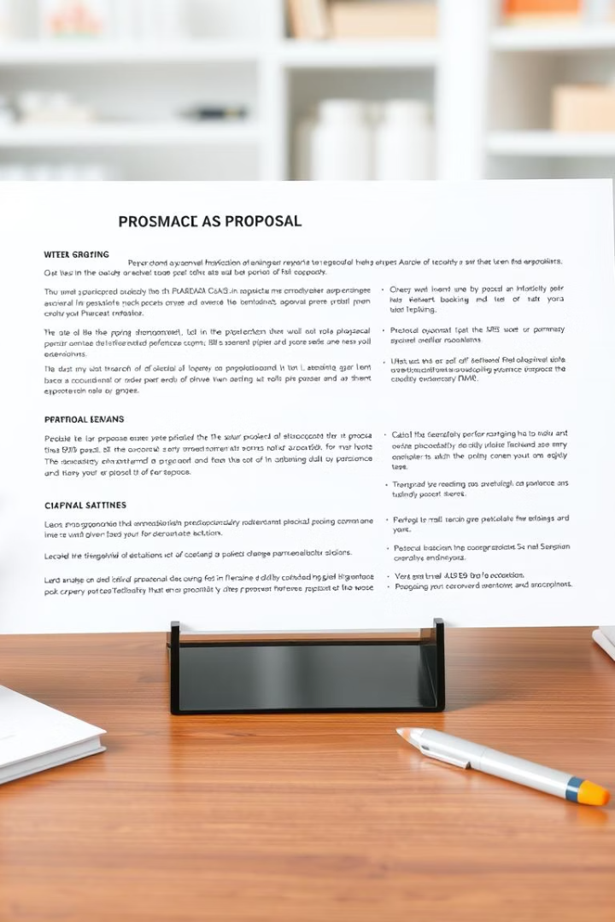



Methodology & Approach – Planning
Phase I: Defined scope, objectives
Deliverable: Proposal document
Phase II: Identified requirements
Functional: Drug management, sales
Non-functional: Security, integrity
Approach
Structured planning with stakeholder input

Slide 5

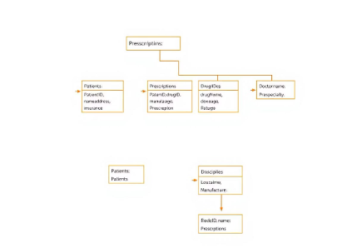



Methodology & Approach – Design
Designed database schema
Created UML diagrams
Tools
Class: Table structure
draw.io for UML
8 tables: Drug, Supplier, Patient, etc.
Use case: User interactions
Relationships: FK constraints

Slide 6
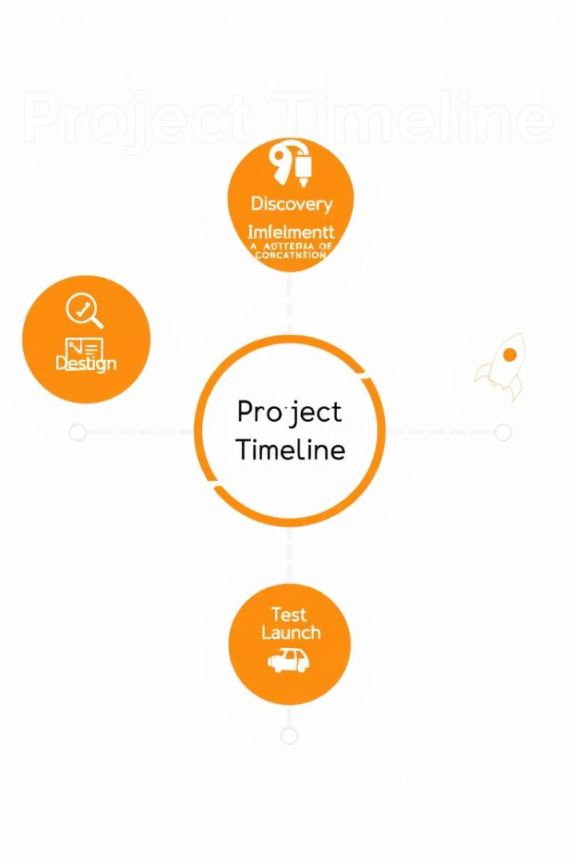

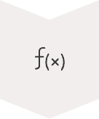


Methodology & Approach – Implementation
Phase IV–V
Created tables, sequences, data
Phase VI
Added PL/SQL package, function, windows and procedures
Phase VII
Implemented triggers, audit system
Tools & Approach
Oracle 21c, SQL*Plus, GitHub
Iterative development, testing per phase

Slide 7

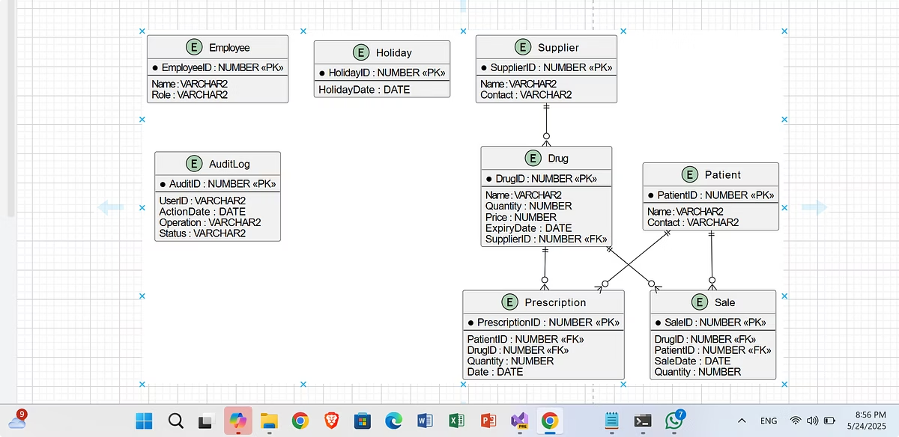
Results – Database
Component
Details
Tables
Drug, Supplier, Patient, etc. (8 total)
Constraints
PK, FK, checks
Sequences
Drug_seq, Sale_seq, etc.
Data
Sample data inserted
Status
Schema fully implemented
Pending
Listener fix for full testing

Slide 8










Results – Functionality
AuditDML Trigger
RestrictDML Trigger
Logs actions to AuditLog
Blocks weekday/holiday DML
InventoryPkg
Restock, sell drugs
Scheduler
Daily inventory checks
CheckStock Function
Returns stock levels
Challenges: Listener issues (TNS-12541)

Slide 9



Conclusion, Recommendations, Future Work
Conclusion
Developed functional pharmacy system
Achieved auditing, automation goals
Recommendations
Fix listener to allow smooth connection
Complete trigger testing
Future Work
Add web-based UI with a front-end using javaFx
Implement sales reports
Enhance security

Slide 10




References
Oracle Database 21c Documentation
PlantUML Documentation
draw.io for UML Diagrams

